Slide 1


Green Pace Policy Presentation
Developer: Dominoe LaMattina
Course: CS 405 Secure Coding
Date: October 2025
Notes:
Hello everyone, I’m Dominoe LaMattina, and today I’ll be presenting the Green Pace Security Policy. This presentation summarizes the secure-coding principles, standards, and automated testing methods we’ve implemented to protect Green Pace systems and applications.

Slide 2

Overview: Defense in Depth
Consistent, layered security model
Combines people, process, and technology
Goal: prevent, detect, and contain threats
Policy ensures uniform secure-coding practices
Notes:
The Green Pace policy was created to standardize secure development across all teams. Our defense-in-depth approach layers controls; validation, least privilege, sandboxing, and monitoring; so if one layer fails, others still protect the system. This ensures consistency and resilience across all applications.

Slide 3

Threat Matix
| Rule | Severity | Likelihood | Priority | Level | | STD-001 Data Type Correctness | High | Low | High | 2 | | STD-002 Data Value Validation | High | Medium | High | 3 | | STD-003 String Correctness | High | Low | High | 3 | | STD-004 SQL Injection | High | Medium | High | 3 | | STD-005 Memory Protection | High | Medium | High | 3 | | STD-006 Assertions | Medium | Medium | Medium | 2 | | STD-007 Exceptions | Medium | Low | Medium | 2 | | STD-008 Initialization Safety | High | Medium | High | 3 | | STD-009 RAII for Resources | High | Medium | High | 3 | | STD-010 Bound-Safe Interfaces | High | Medium | High | 3 |
Notes:
This threat matrix summarizes all ten standards with their severity, likelihood, and priority ratings. Most issues fall at level 3, meaning they pose a significant security risk if left unmitigated. Automation through static analysis ensures we identify and address these threats early in development.

Slide 4

Ten Principles
Validate Input Data
Heed Compiler Warnings
Architect and Design for Security
Keep It Simple
Default Deny
Least Privilege
Sanitize Data Sent to Other Systems
Practice Defense in Depth
Use Effective QA Techniques
Adopt a Secure Coding Standard
Notes:
These ten principles are the backbone of Green Pace’s policy. They guide every design and code decision; from validating inputs and enforcing least privilege, to ensuring simple, maintainable structures and consistent security throughout our development lifecycle.

Slide 5

Coding Standards Policy
Ten C/C++ standards derived from SEI CERT and C++ Core Guidelines
Prioritized by risk impact and likelihood
Automated checks: SonarQube, clang-tidy, Cppcheck
Continuous enforcement through CI/CD
Notes:
Our coding standards were prioritized based on how critical each vulnerability is and how likely it is to occur. Each rule ties directly to a principle; for example, Data Value Validation supports “Validate Input Data” and “Defense in Depth.” Static analysis tools automatically flag violations before code merges, keeping compliance consistent.

Slide 6

Encryption Strategy
At Rest: AES-256 for disks & databases (KMS key rotation)
In Flight: TLS 1.3 for all network traffic
In Use: Secure enclaves (SGX/SEV) & memory isolation
Protects data lifecycle end-to-end
Notes:
Encryption protects Green Pace data wherever it exists. At rest, we use AES-256 with managed key rotation. In flight, all communication is protected with TLS 1.3. And for encryption in use, secure enclaves isolate sensitive computations, preventing data exposure even during processing.

Slide 7
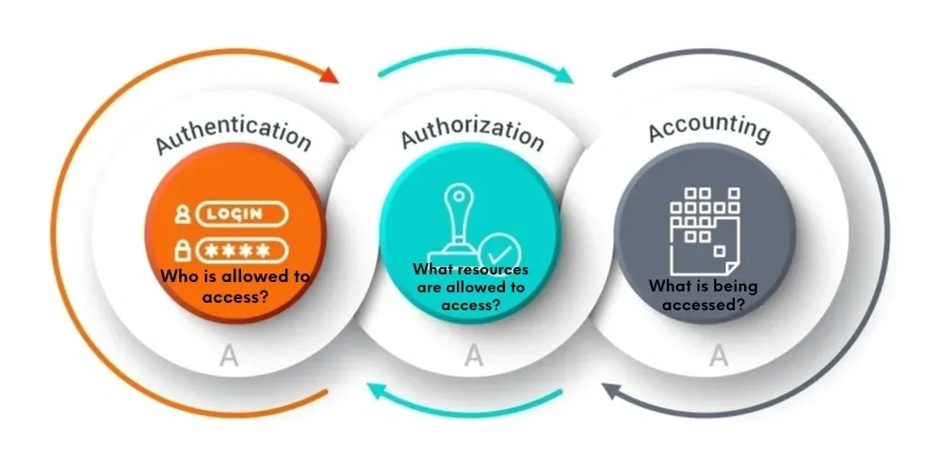
Triple-A Framework
Authentication: MFA + hashed credentials (Argon2/bcrypt)
Authorization: RBAC + least privilege reviews quarterly
Accounting: Immutable centralized logs for SOC audit
Supports Zero Trust and regulatory compliance
Notes:
The Triple-A framework reinforces our identity and access controls. Authentication uses multi-factor verification and strong password hashing. Authorization applies role-based and least-privilege policies. And accounting ensures every access and configuration change is logged for traceability and rapid incident response.

Slide 8

Unit Testing: Data Validation
Focus: Numeric Overflow Protection (STD-002)
Unit Tests Created in Visual Studio using Google Test
Positive Tests: Valid length calculations → Pass
Negative Tests: Overflow inputs → Throw exception
External Tools: clang-tidy + Cppcheck confirm coverage
Notes:
For unit testing, I chose to demonstrate numeric overflow protection. In Visual Studio, we used Google Test to verify safe length calculations. Positive tests confirmed valid arithmetic works as expected, while negative tests triggered exceptions on overflow. Static analyzers, like clang-tidy and Cppcheck, validated coverage automatically.

Slide 9

Automation Summary
Continuous Integration runs SonarQube, clang-tidy, Cppcheck
Fails pipeline if quality gates don’t pass
Continuous Monitoring for config drift & vulnerabilities
Feedback loops to Risk Management Dashboard
Notes:
Automation enforces compliance throughout our DevSecOps pipeline. Every commit triggers static analysis and unit tests; builds fail if issues are found. In production, continuous monitoring detects configuration drift or new vulnerabilities. Results feed directly into the risk dashboard for visibility and accountability.

Slide 10

Risks & Benefits
Immediate Action: Prevents data breaches and downtime
Delaying Mitigation: Increases attack surface and cost
Benefit: Standardized policy ensures long-term resilience
Risk: Ongoing tool maintenance required
Notes:
Acting now to enforce these standards prevents costly data breaches and reputational harm. Waiting only increases our attack surface and remediation expenses. The benefit is a consistent, resilient security culture, though maintaining and updating our automation tools will require continual attention.

Slide 11

Recommendations and Conclusion
Address gaps through enhanced secure code reviews
Integrate fuzz testing into CI for unknown vulnerabilities
Expand threat modeling for future projects
Continue annual policy reviews and training
Notes:
Looking ahead, Green Pace should continue refining secure code reviews, introduce fuzz testing to uncover hidden vulnerabilities, and expand threat modeling early in design. Annual policy reviews and team training will sustain our secure-by-design culture as threats evolve.

Slide 12
References
Carnegie Mellon University, Software Engineering Institute. (2025). CERT C/C++ secure coding standard. Retrieved October 2025 from https://wiki.sei.cmu.edu/confluence/display/cplusplus
Cloud Security Alliance. (2025). Confidential computing and data protection best practices. Retrieved October 2025 from https://cloudsecurityalliance.org/
CISA – Cybersecurity and Infrastructure Security Agency. (2025). Zero trust maturity model version 2.0. Retrieved October 2025 from https://www.cisa.gov/resources-tools/resources/zero-trust-maturity-model
Cppcheck Team. (2024). Cppcheck manual (v2.18). Retrieved October 2025 from https://cppcheck.sourceforge.io/manual.pdf
IETF – Internet Engineering Task Force. (2018). RFC 8446: The transport layer security (TLS) protocol version 1.3. Retrieved October 2025 from https://datatracker.ietf.org/doc/html/rfc8446
LLVM Project. (2025). clang-tidy 18 documentation. Retrieved October 2025 from https://releases.llvm.org/18.1.1/tools/clang/tools/extra/docs/clang-tidy/index.html
Microsoft. (2025). Azure storage encryption for data at rest. Retrieved October 2025 from https://learn.microsoft.com/en-us/azure/security/fundamentals/encryption-atrest
MITRE. (2025). Common weakness enumeration (CWE). Retrieved October 2025 from https://cwe.mitre.org
National Institute of Standards and Technology (NIST). (2020). FIPS 197: Advanced encryption standard (AES). Retrieved October 2025 from https://csrc.nist.gov/publications/detail/fips/197/final
National Institute of Standards and Technology (NIST). (2023). Special publication 800-63B: Digital identity guidelines – authentication and lifecycle management. Retrieved October 2025 from https://pages.nist.gov/800-63-3/sp800-63b.html
National Institute of Standards and Technology (NIST). (2022). SP 800-204C: Implementation of DevSecOps for cloud-native applications. Retrieved October 2025 from https://nvlpubs.nist.gov/nistpubs/SpecialPublications/NIST.SP.800-204C.pdf
OWASP Foundation. (2025a). Cryptographic storage cheat sheet. Retrieved October 2025 from https://cheatsheetseries.owasp.org/cheatsheets/Cryptographic_Storage_Cheat_Sheet.html
OWASP Foundation. (2025b). Transport layer security (TLS) cheat sheet. Retrieved October 2025 from https://cheatsheetseries.owasp.org/cheatsheets/Transport_Layer_Security_Cheat_Sheet.html
OWASP Foundation. (2025c). Key management cheat sheet. Retrieved October 2025 from https://cheatsheetseries.owasp.org/cheatsheets/Key_Management_Cheat_Sheet.html
OWASP Foundation. (2025d). DevSecOps maturity model (DSOMM). Retrieved October 2025 from https://owasp.org/www-project-devsecops-maturity-model/
SonarSource. (2025). C static code analysis rules. Retrieved October 2025 from https://rules.sonarsource.com/c/
Stroustrup, B., Sutter, H., & ISO C++ Working Group. (2025). C++ core guidelines. Retrieved October 2025 from https://isocpp.github.io/CppCoreGuidelines/CppCoreGuidelines
Notes:
These references supported the creation of Green Pace’s secure development policy, aligning our standards with recognized authorities like SEI CERT, OWASP, NIST, and CISA. Together, they form the foundation of a sustainable and proactive defense-in-depth strategy.

